Slide 1
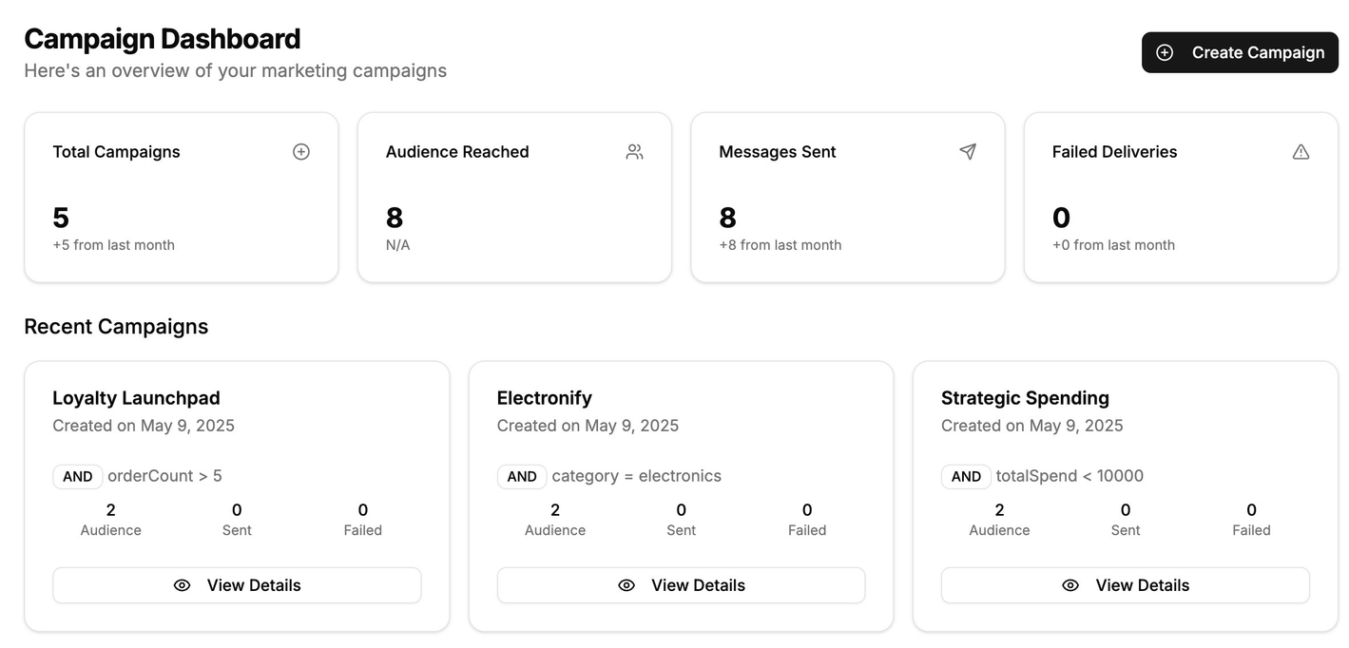
ClientNest - CRM
XENO SDE INTERNSHIP ASSIGNMENT
Chayan Mann
College: Maharaja Agrasen Institute of Technolog
Branch : AI-ML

Slide 2

APPROACH

Slide 3



FEATURES
Asynchronous, Scalable Message Delivery
Delivery Tracking & Communication History
Rule-based Campaign Engine

Slide 4












TECH STACK

